Slide 1

LE QUY DON SECONDARY SCHOOL
WELCOME TO OUR CLASS !
CLASS : 9A4
TEACHER : MAI THUY

Slide 2
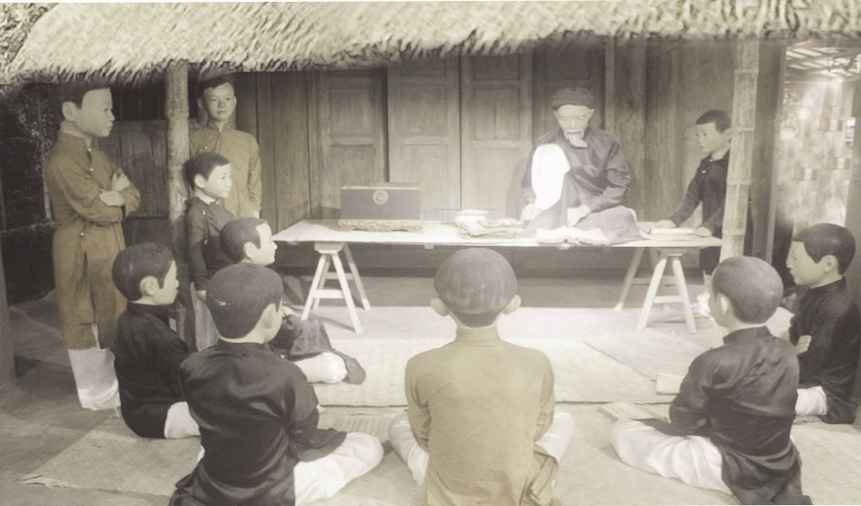
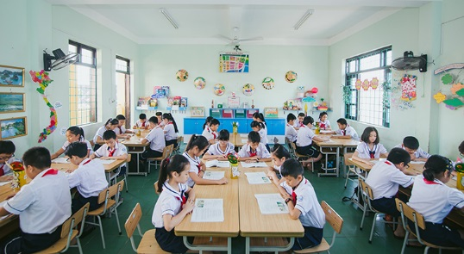

Slide 3

Monday, November 30th, 2020
LIFE IN THE PAST
PROJECT

Slide 4
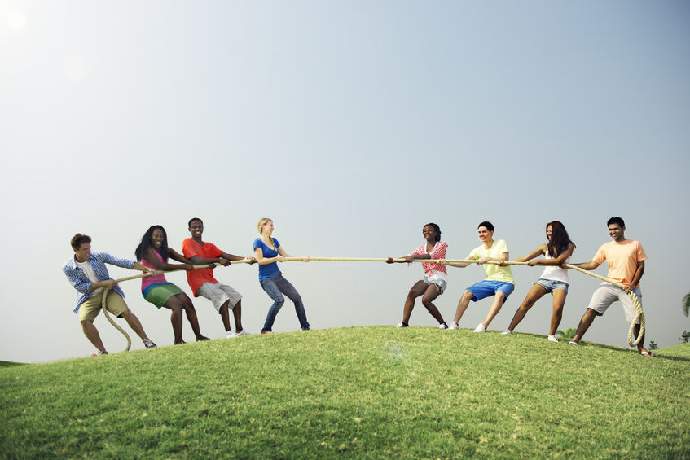

Slide 5

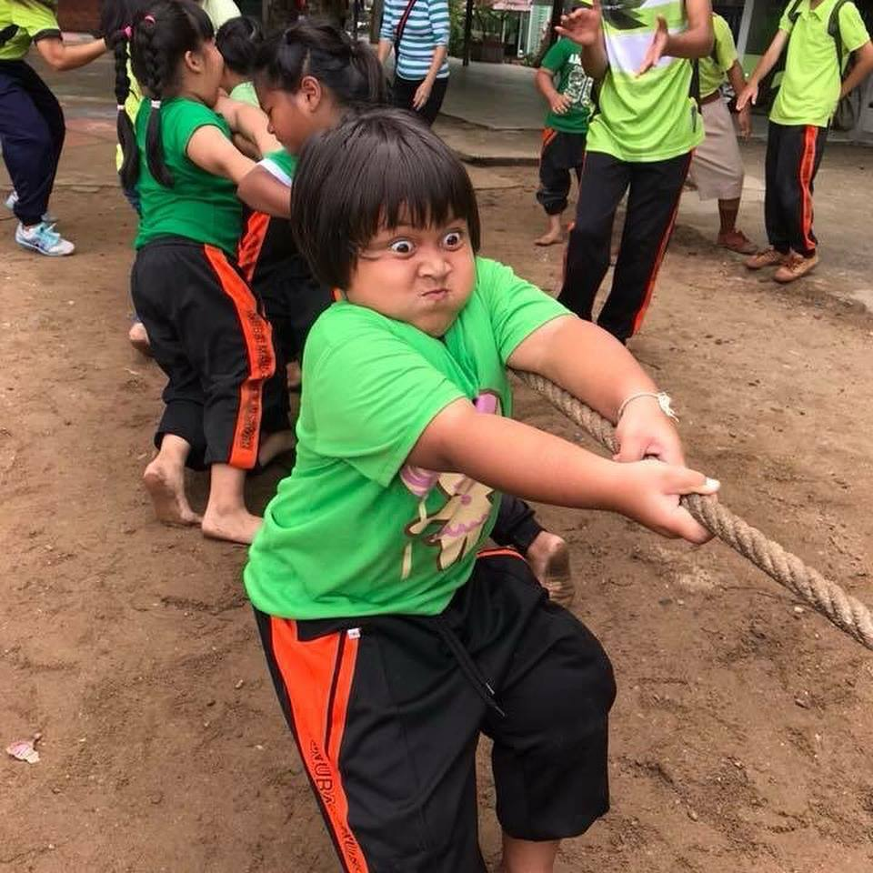

Slide 6
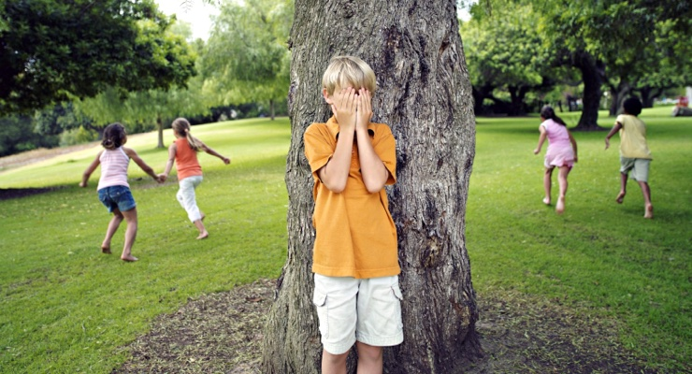
Ones player closes his eyes and counts to 100 while the other players hide
The seeker then opens his eyes and tries to find the hiders

Slide 7
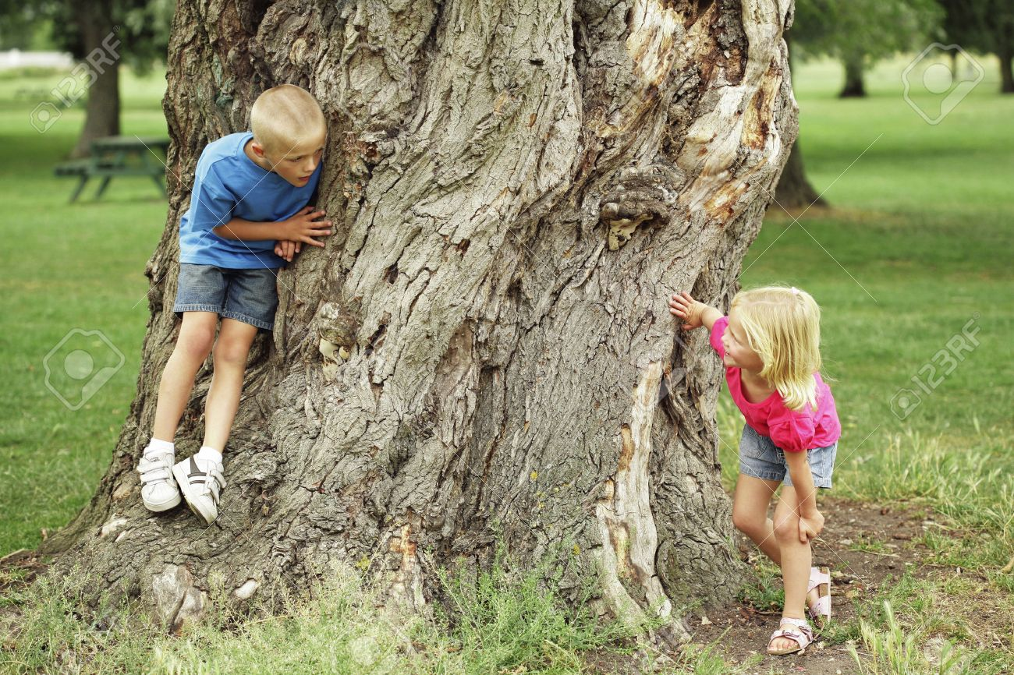

Slide 8
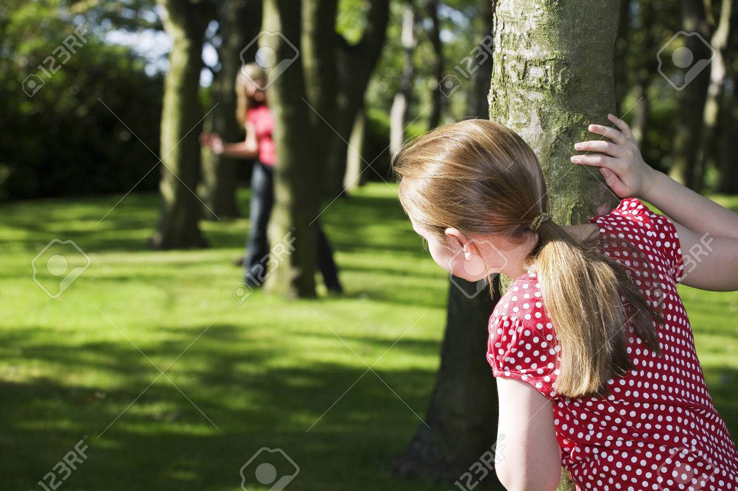
In one of many forms of the game, the hiders try to come back “ home base “ while the seeker is away looking for them

Slide 9
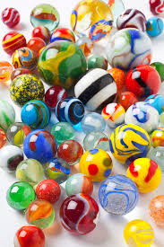
Marble, small, hard ball that is used in a variety of children’s games.
Marbles have been made of a variety of other materials as well: baked clay, glass, steel, plastic, …

Slide 10
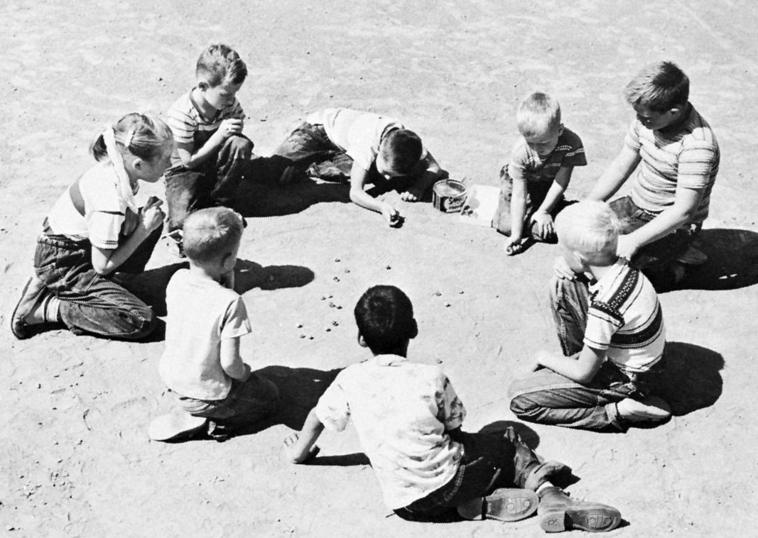
- Players attempt to shoot marbles, sometimes arranged in a cross, out of ring as much as about 2 or 3 metres in diameter
- Players try to shoot marbles beat an opponent’s marbles

Slide 11
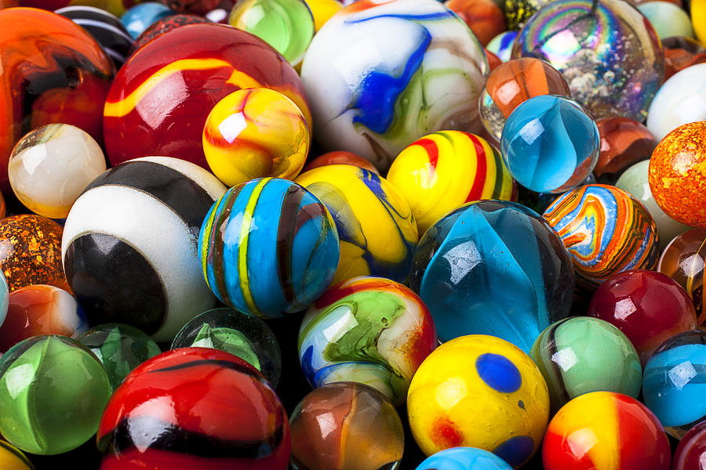

Slide 12
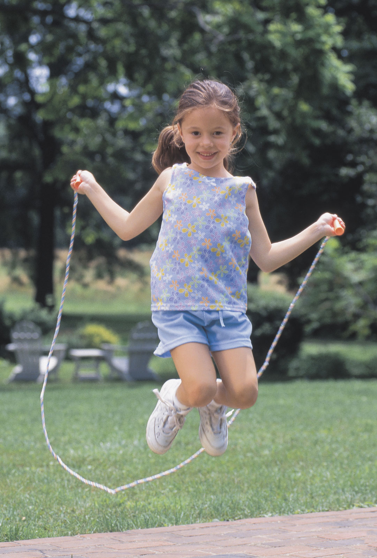
There are multiple subsets of jump rope including: single freestyle, single speed, pairs, three person speed (double dutch), and three person freestyle (double dutch freestyle)
In speed events, a jumper alternates his or her feet with the rope going around the jumper every time one of their feet hit the ground for 30 seconds, one minute, or three minutes.

Slide 13
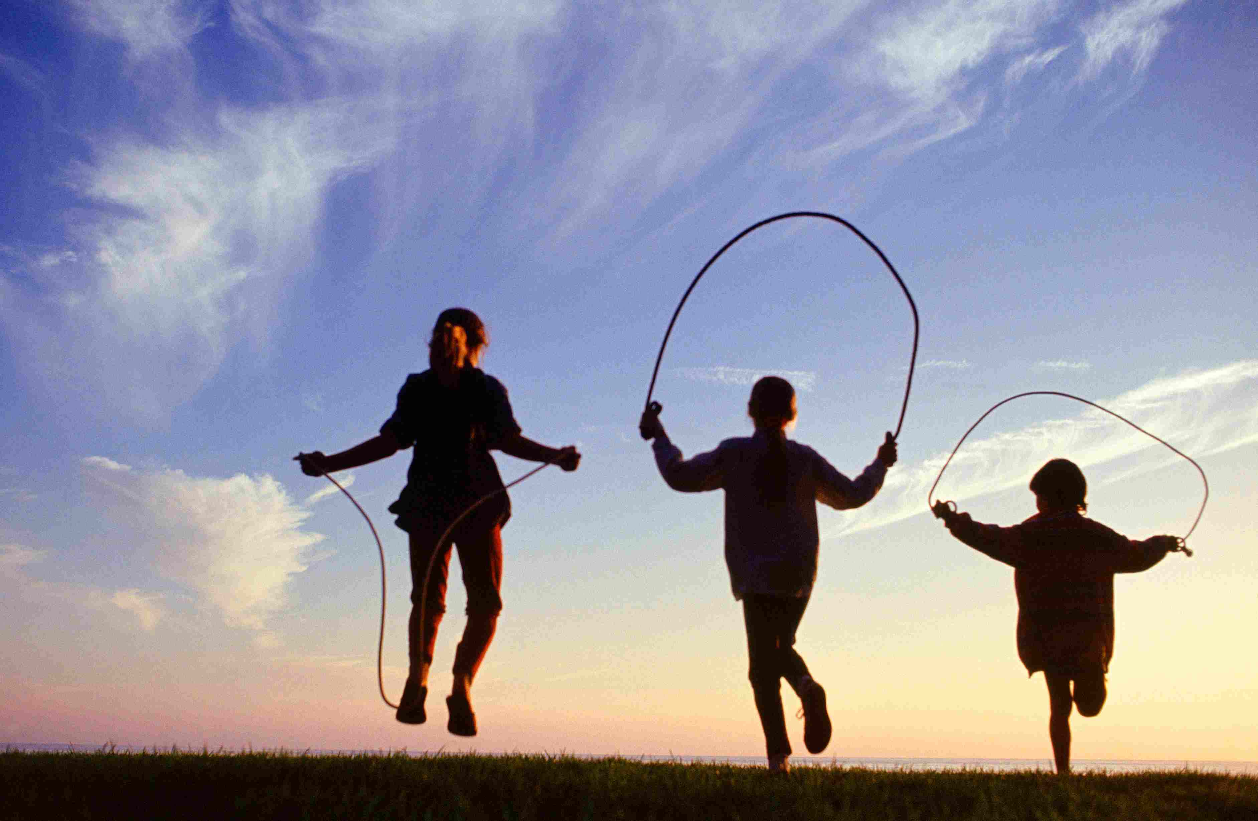

Slide 14

HOMEWORK:
- Review grammar
+ Used to/ didn’t use to/ Did…use to

